Slide 1


Automation
Scheduling
Python
Orchestration Monitoring Pipeline

Slide 2
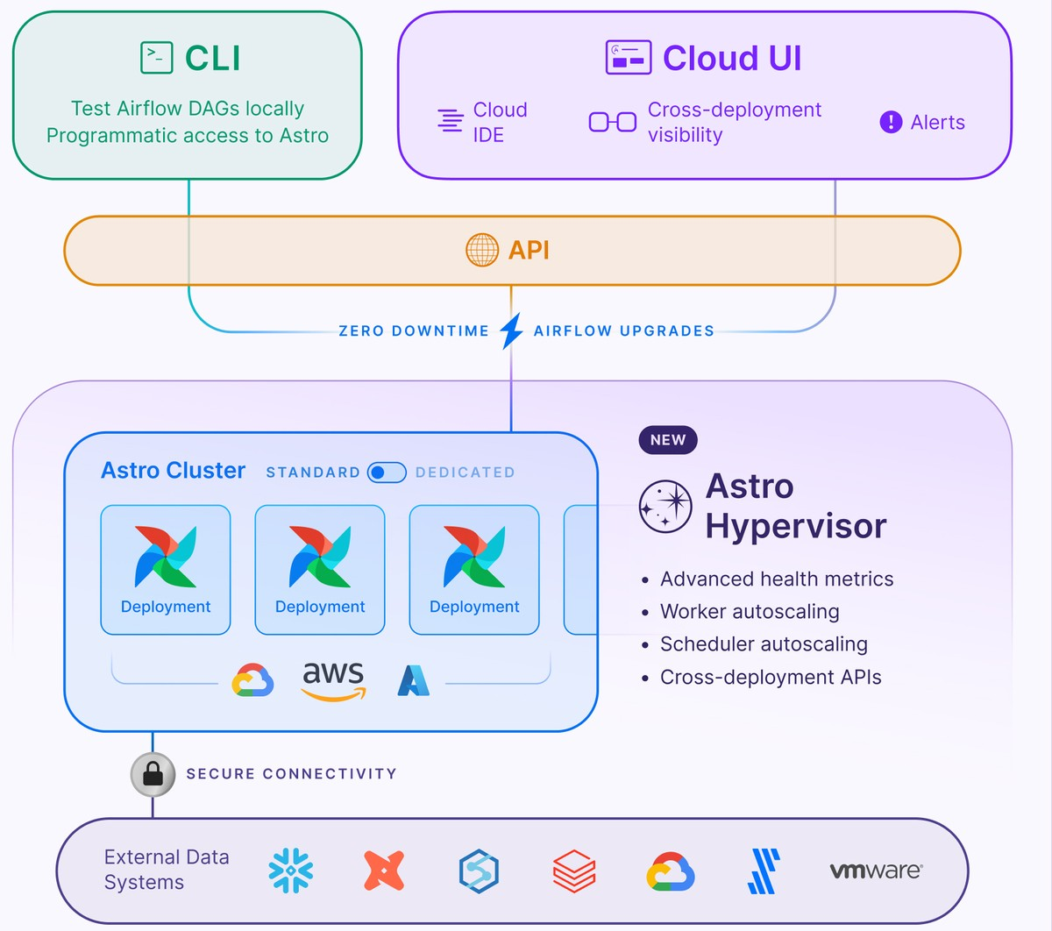
Airflow Architecture (Astro)

Slide 3
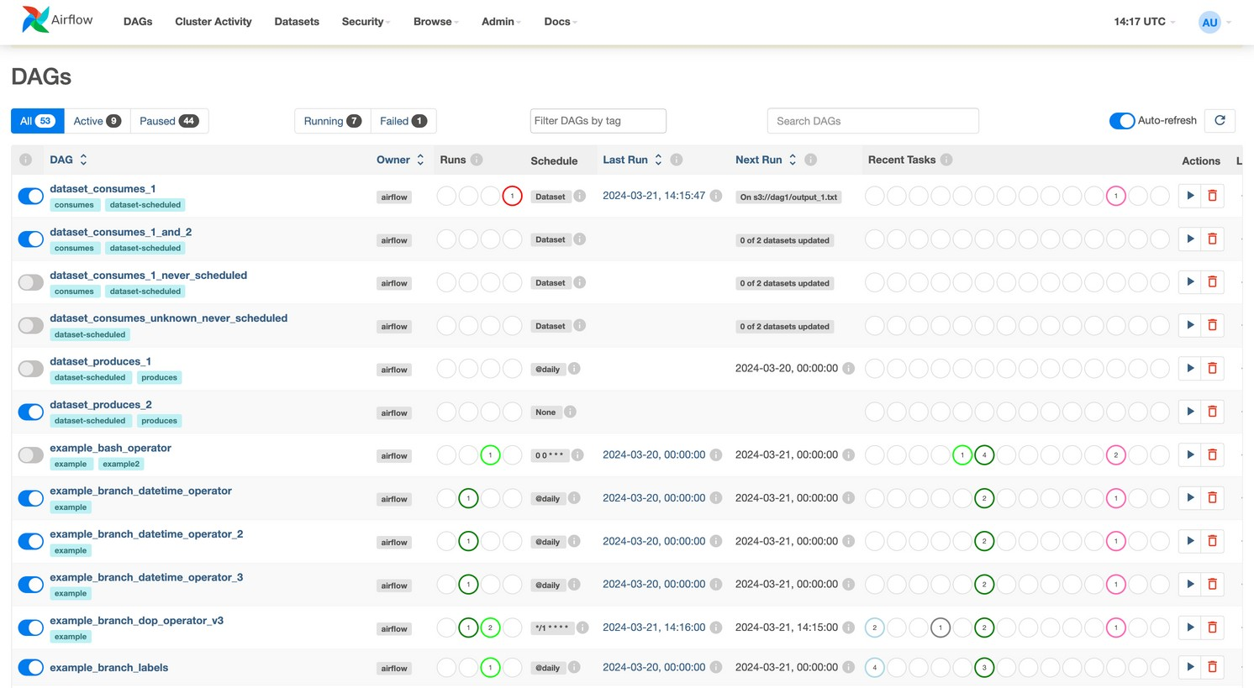
Apache Airflow
Apache Airflow is an open-source tool for creating, scheduling, and monitoring workflows as code, using DAGs (Directed Acyclic Graphs) to define task dependencies and manage execution, retries, and failures.
Airflow Web UI (Enable/Disable DAGS ,Monitor,Refresh)

Slide 4

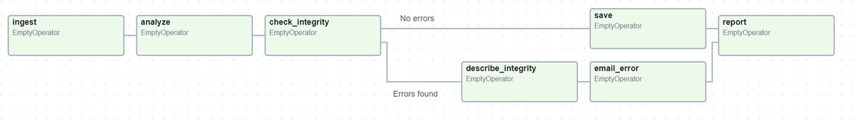
Airflow DAG
DAGs (Directed Acyclic Graphs) -
A DAG represents the overall structure of a workflow in Airflow
An Airflow DAG (Directed Acyclic Graph) is a collection of tasks in a workflow, with specified execution order and dependencies. Written in Python, it ensures tasks run in sequence without loops, allowing users to define complex workflows ,including scheduling and logic.
A DAG defines task dependencies, determining their execution order, while tasks specify the actions, such as fetching data, running analyses, or triggering other systems.

Slide 5
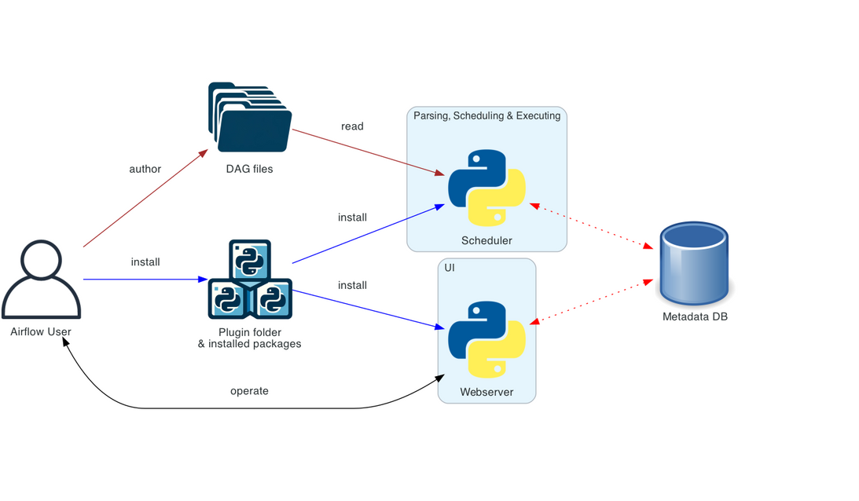
Architect-Data Engineering & Analytics Career Transition Coach
Airflow Architecture
The diagrams below show different ways to deploy Airflow - gradually from the simple “one machine” and single person deployment, to a more complex deployment with separate components, separate user roles and finally with more isolated security perimeters.

Slide 6
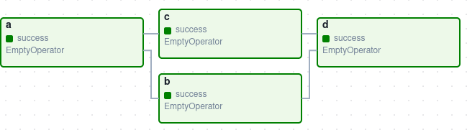
Create a DAG
Design a Basic DAG -
It defines four Tasks - A, B, C, and D - and dictates the order in which they have to run, and which tasks depend on what others. It will also say how often to run the DAG - maybe “every 5 minutes starting tomorrow”, or “every day since January 1st, 2020”.

Slide 7
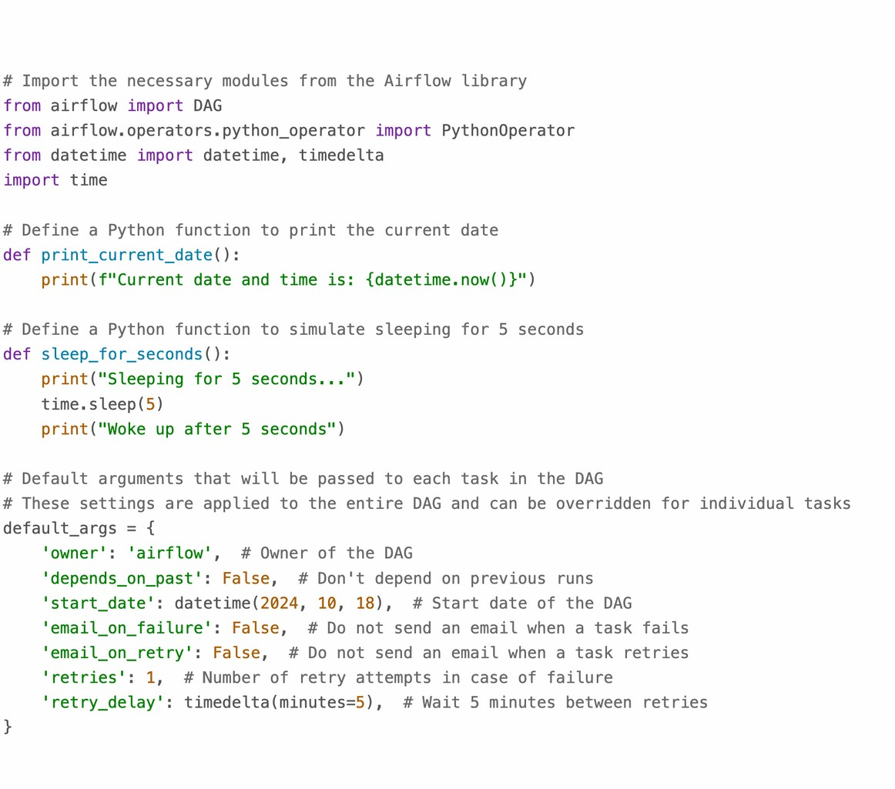
Architect-Data Engineering & Analytics Career Transition Coach
Python program DAG
Part 1//2

Slide 8
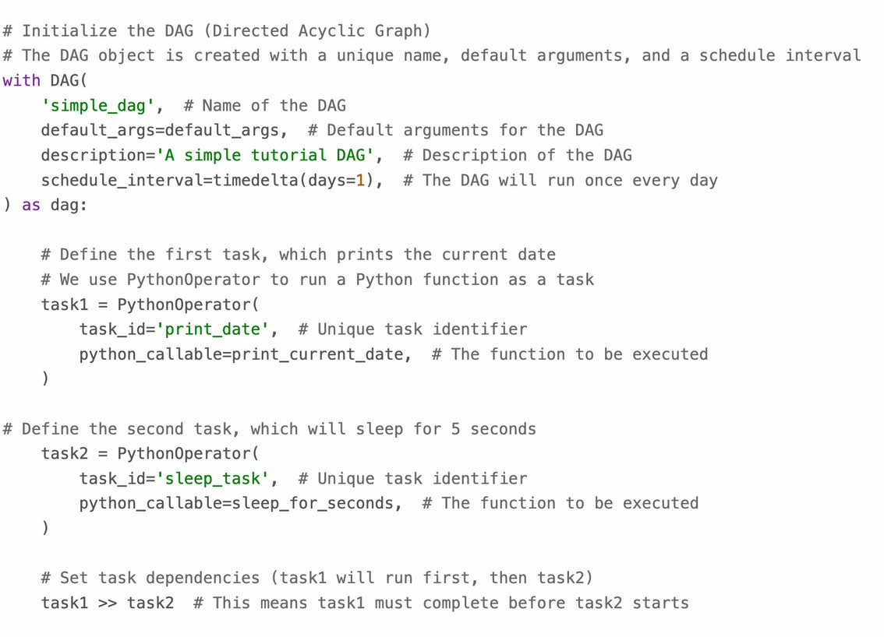

Python program DAG
Part 2//2
Then Deploy python code in GIT/AWS S3 based on repo (it’s very simple)
DAG will display in Airflow UI once you place DAG code

Slide 9
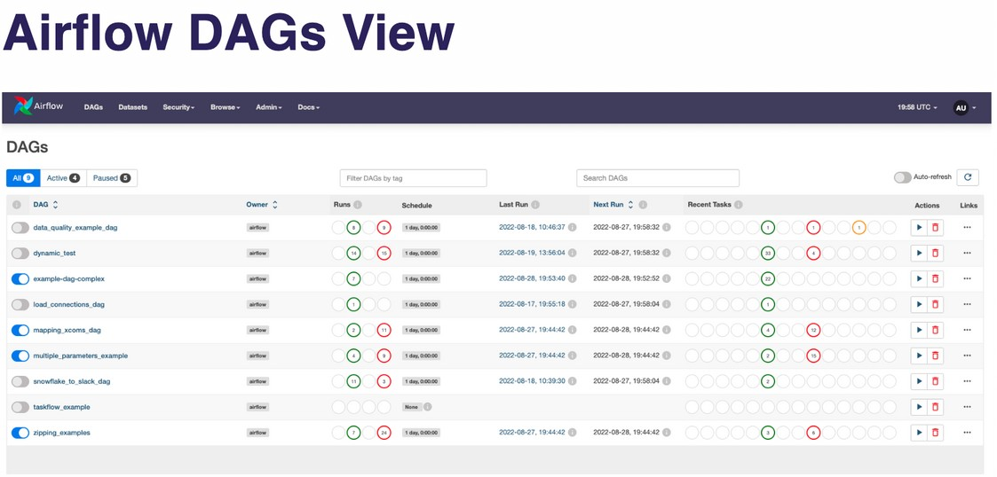
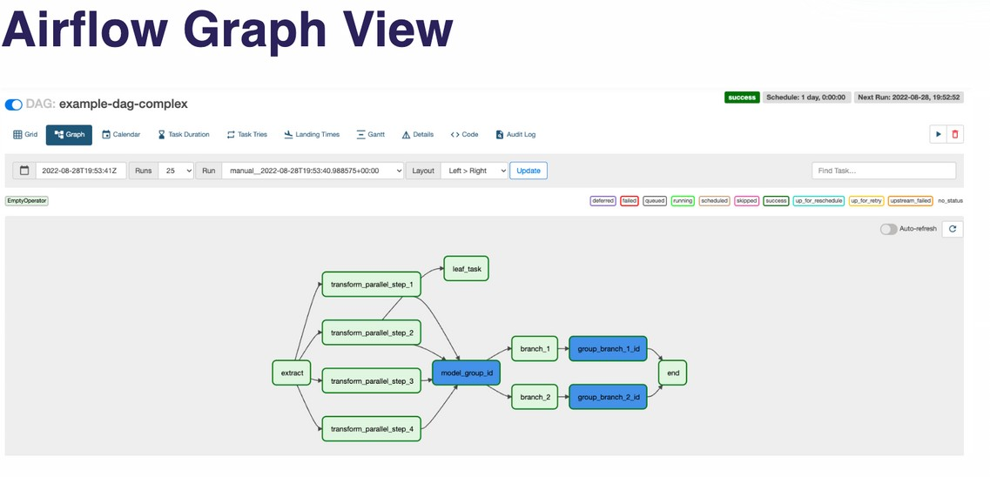
Architect-Data Engineering & Analytics Career Transition Coach
Ways to View and Manage DAGs in Airflow

Slide 10
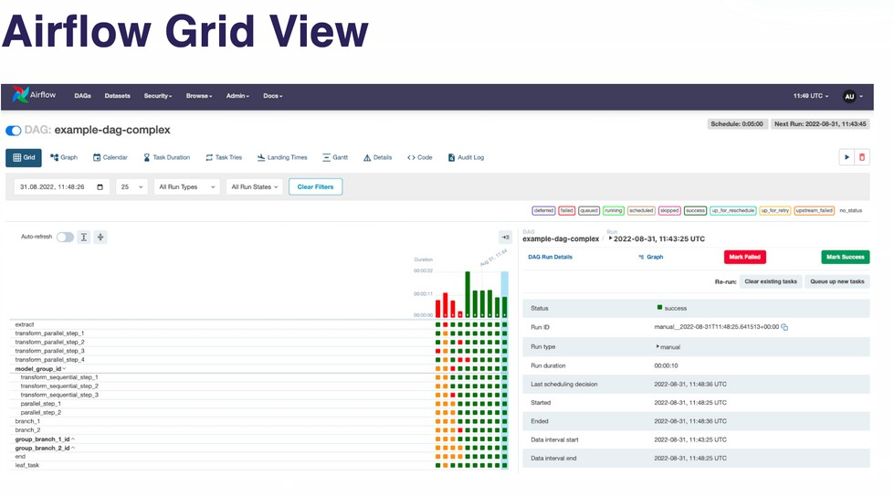
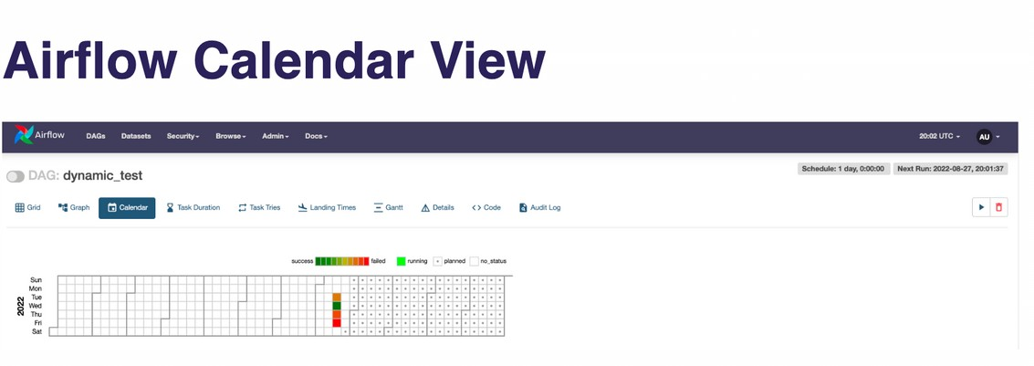
Architect-Data Engineering & Analytics Career Transition Coach
Ways to View and Manage DAGs in Airflow

Slide 11
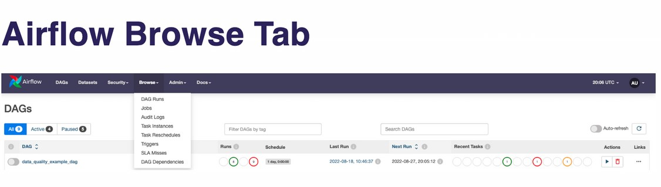
Architect-Data Engineering & Analytics Career Transition Coach
Ways to View and Manage DAGs in Airflow

Slide 12

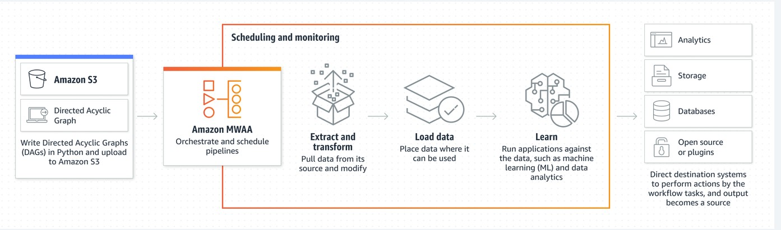
Architect-Data Engineering & Analytics Career Transition Coach
cloud providers that offer Airflow services
Amazon Web Services (AWS) -
Amazon Managed Workflows for Apache Airflow (MWAA) is a fully managed Airflow service on AWS

Slide 13

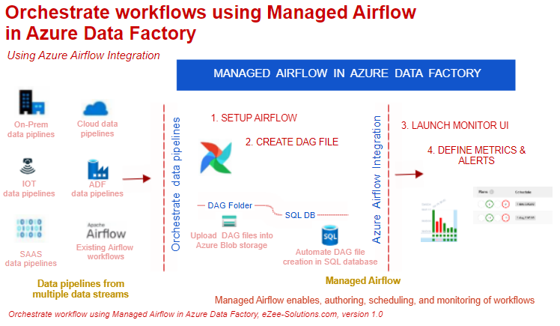
cloud providers that offer Airflow services
Microsoft Azure
Apache Airflow integrates with Microsoft Azure services through Microsoft. azure provider. You can install any provider package by editing the airflow environment from the Azure Data Factory UI
Apache Airflow™ on Astro - An Azure Native Service

Slide 14

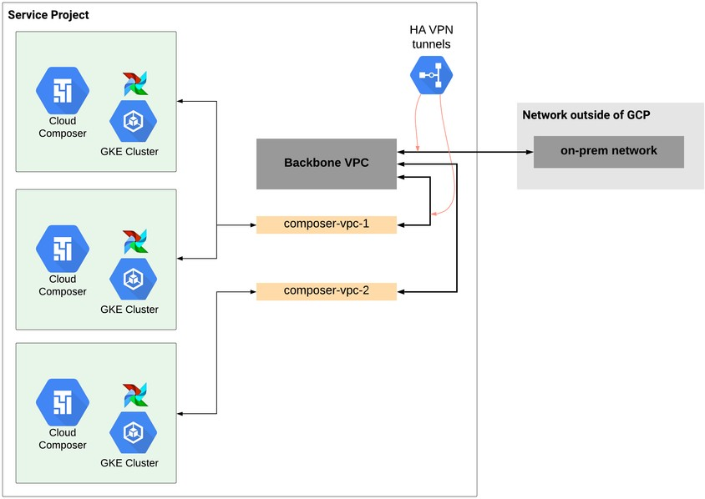
Architect-Data Engineering & Analytics Career Transition Coach
cloud providers that offer Airflow services
Google Cloud Platform (GCP)-
Cloud Composer is a fully managed workflow orchestration service that runs on GCP. It's built on the Apache Airflow open source project

Slide 15

Architect-Data Engineering & Analytics Career Transition Coach
cloud providers that offer Airflow services
Astronomer -
A managed Airflow service that allows data teams to build, run, and manage data pipelines as code. Astronomer can run Airflow on AWS, GCP, Azure, or on-premise

Slide 16

Feel Free to Book 1:1 Call
for transition into Data Engineering & Analytics
Ganesh R
Senior Data engineer

